Slide 1
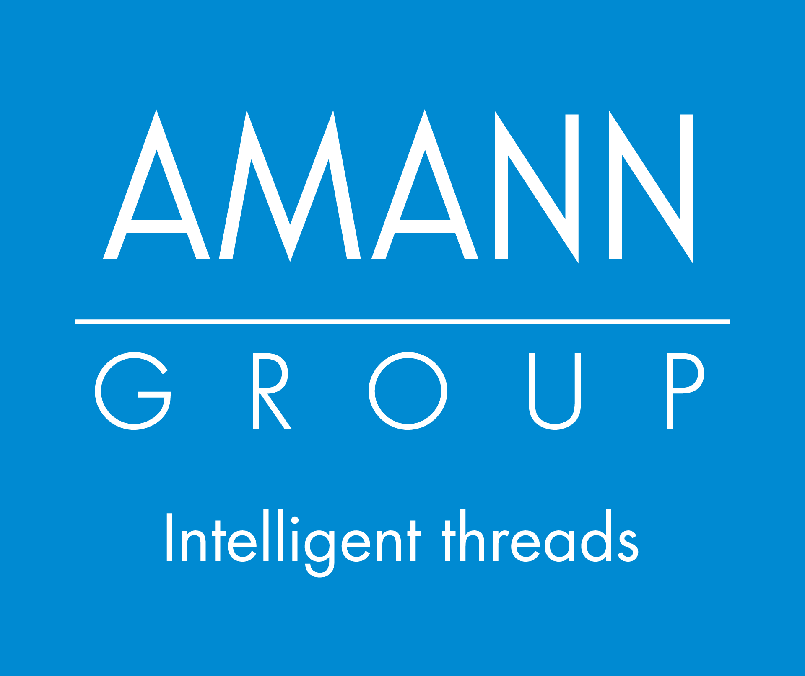



AMANN UK SITE OVERVIEW
LEARNING NUGGET LN-005
Draft

Slide 2
AMANN UK SITE OVERVIEW
AMANN UK Learning Hub
Learning Nugget LN-005
By AMANN Group
©2025 | Operations Manager ROYSTON BIRKIN
Mobile 07701217695
E-Mail Royston.Birkin@amann.com
Version05 – 04.10.2025

Slide 3
Learning Nugget 005 provides a concise, professional introduction to the site and its flow of goods. It outlines the basic setup, layout, and key process interfaces—showing where materials enter, how they move through operations, and where they exit. By the end, learners gain a clear, high-level overview that prepares them for deeper operational modules and on-the-job application.

Slide 4
Why It’s Important to Understand the AMANN UK Site
Gaining a clear understanding of the AMANN UK site's structure and value stream helps every employee see how their work contributes to the bigger picture.
By knowing how products flow through each department — from — employees can:Twisting to Dyeing, Bonding, and Final Winding
Understand where and how value is created
See how departments connect and rely on each other
Recognize the importance of quality, efficiency, and teamwork
This knowledge empowers individuals to act with purpose, strengthens collaboration, and supports our shared goal of continuous improvement and job security.

Slide 5
Why Is Production Divided into Cells – and What Does It Mean at AMANN Group UK?
Cell production is a modern manufacturing principle in which related tasks are grouped into dedicated “cells” — self-contained work units responsible for a specific part of the overall process. Each cell typically has its own team, equipment, and often integrated quality control, enabling a more focused and efficient workflow.
What Does This Mean at AMANN Group UK?
At AMANN UK, the main production departments —Twisting, Dyeing, Bonding, and Final Winding — are organized into clearly defined functional cells. This means:
Clearly separated work zones for distinct process steps
Dedicated teams accountable for their output and quality
Faster issue detection thanks to localized KPIs and quality checkpoints
Smooth material handovers from cell to cell, reducing waiting times

Slide 6
Benefits of the Cell Structure at AMANN UK
Increased transparency across the value stream
Improved traceability of issues or delays
Greater ownership and engagement among team members
Flexible resource management
Strong foundation for continuous improvement and lean operations
At AMANN UK, each cell operates like a “mini business unit” within the larger production system — playing a direct role in delivering quality and reliability to the customer.

Slide 7





Company View · Value Stream
1
2
3
4
Twisting
Dyeing
Bonding
Final
winding
Goods in
CELL STRUCTURE
CELL STRUCTURE
CELL STRUCTURE
CELL STRUCTURE
Goods out
A. PREP
A. PREP
QC
Certification on release
B. TWIST
Storage
B. Dying
QC
C. DYE-PREP-PACK
C. Finishing
Polishing
CELL STRUCTURE
D. Quality/Release
D. Quality/Release
QC
QC
Customer
stories
QC
QC
Yarn supply
Sales
HR
Operational
management
QC
Marketing

Slide 8
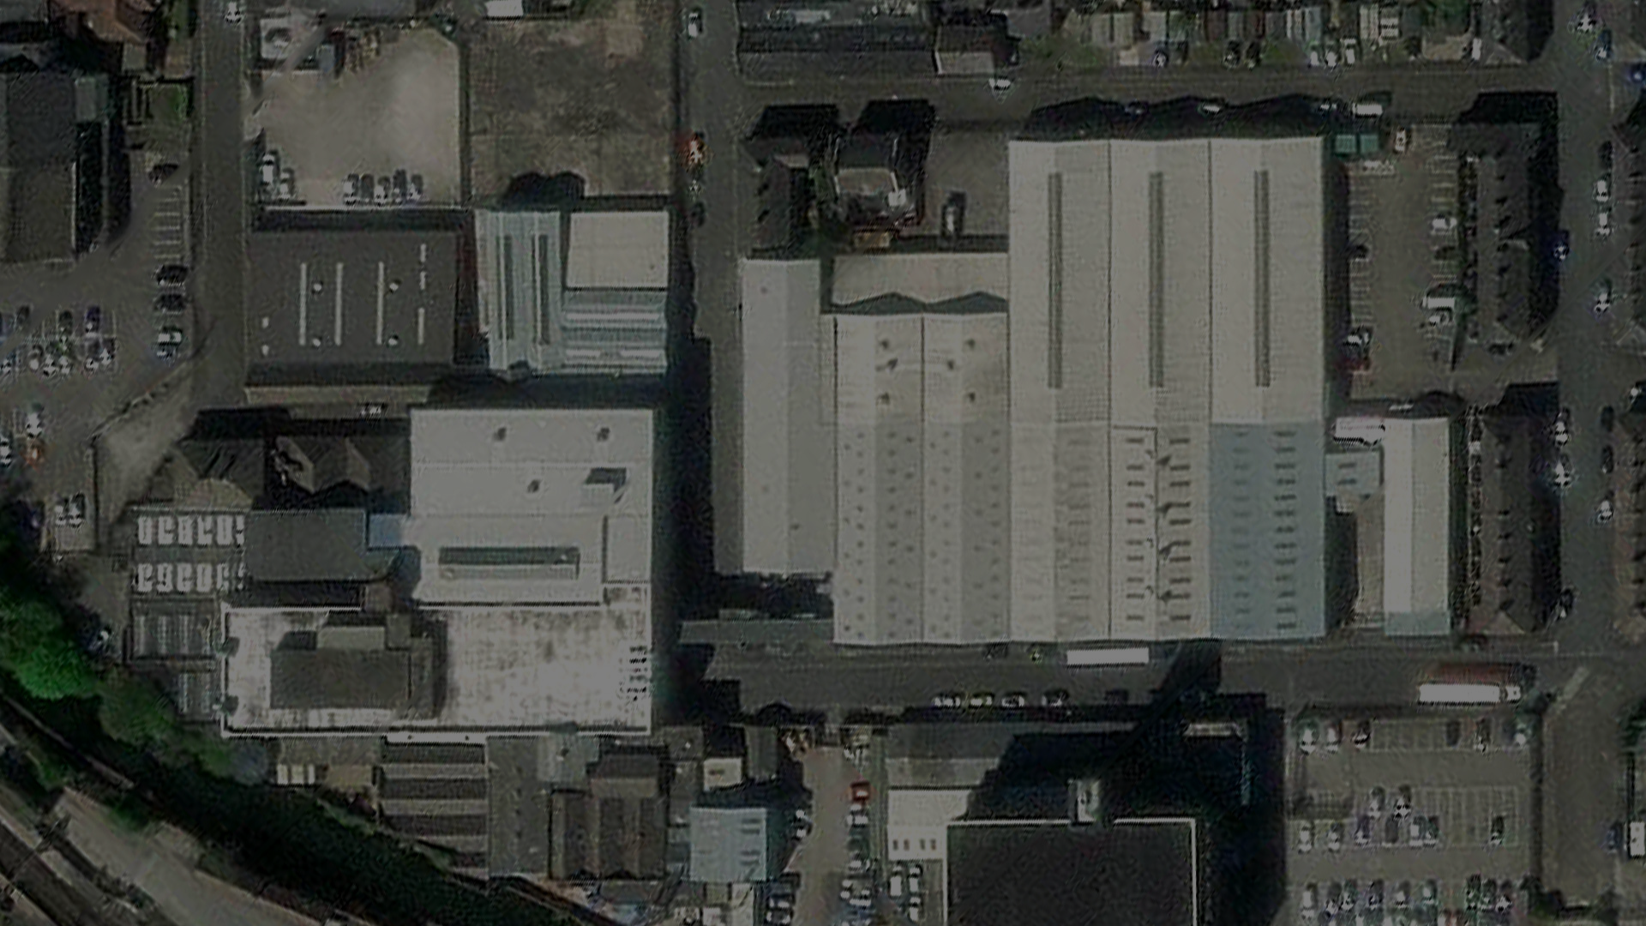





Where are We
GF
GF
1st
2nd
DYE HOUSE
BONDING
POLISHING
FINAL
WINDING
TWISTING

Slide 9
Ground Level 0 –
Dye House
GF
Entrance
Polishing Department
Raw Material Storage
Dye House
Quality Department

Slide 10
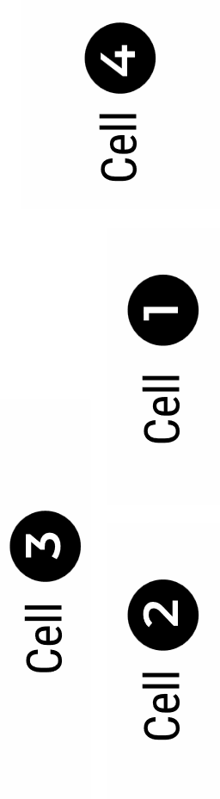
Level 1 –
Final Winding
1st
Final Winding —
Packing area

Slide 11
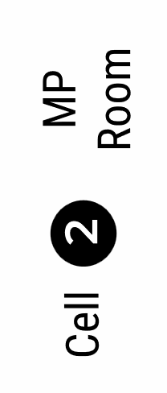
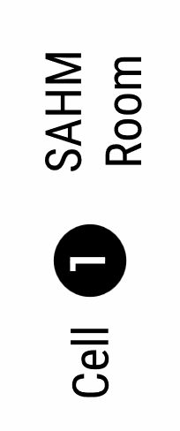
Level 2 –
Bonding Departement
BONDING Department
2nd

Slide 12
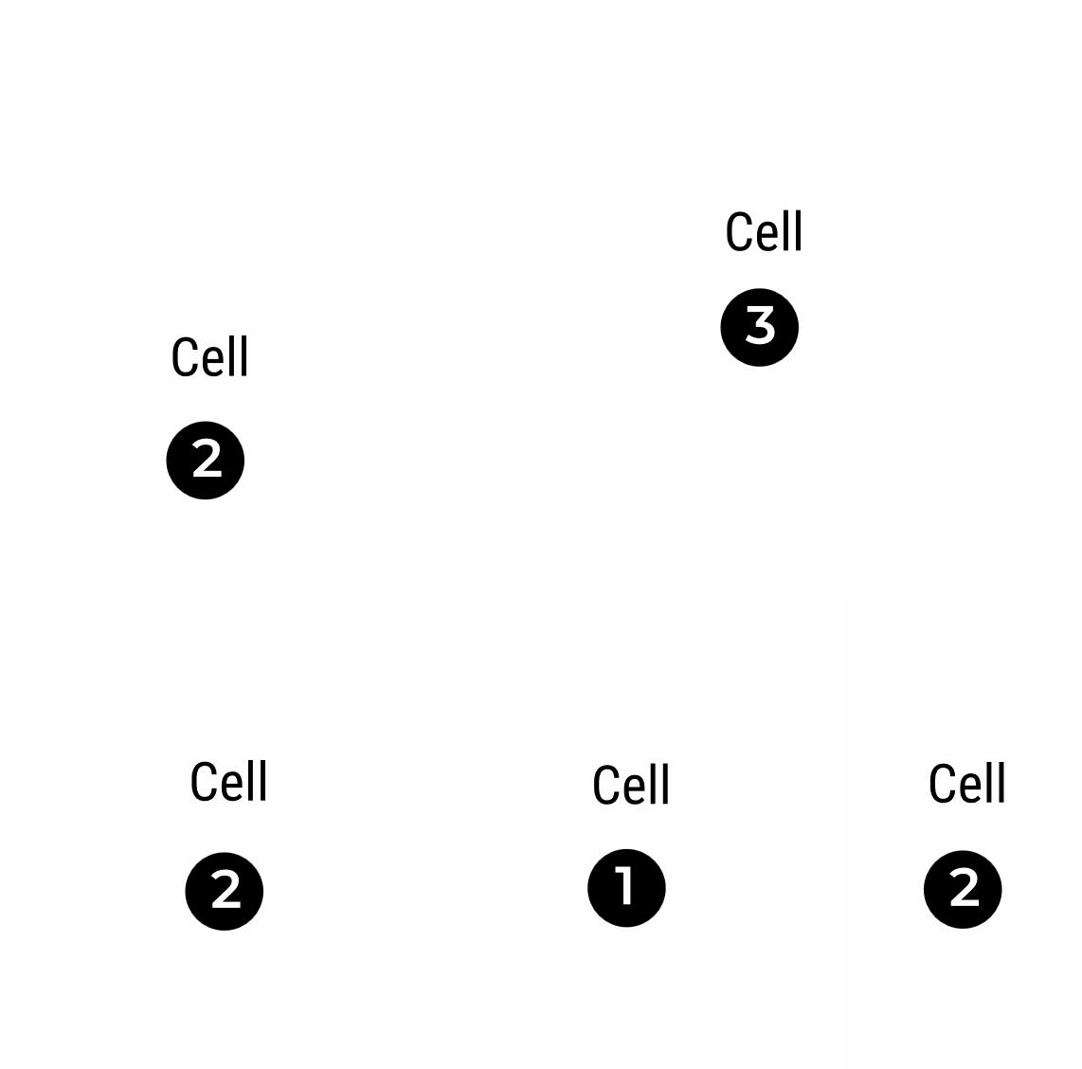
Ground Level –
Twisting Departement
GF
TWISTING Department

