Slide 1




TIER Communication
SQDCP-BOARD
LEARNING NUGGET LN-002
Draft
The SQDCP Board (Safety, Quality, Delivery, Cost, People) is a central tool in our TIER communication system that supports structured and transparent performance dialogue across all layers of the organization — from the shop floor (Tier 1) to senior management (Tier 3+).

Slide 2
TIER Communication — SQDCP-BOARD
AMANN UK Learning Hub
Learning Nugget LN-002
By AMANN Group
©2025 | Operations Manager ROYSTON BIRKIN
Mobile 07701217695
E-Mail Royston.Birkin@amann.com
Version05 – 04.10.2025

Slide 3
Purpose of Learning Nugget 002
This Learning Nugget introduces the internal TIER communication process at AMANN Group.
Its purpose is to:
  Explain the structure and objectives of the 5-tier meeting system
  Promote transparency and consistency in communication across all organizational levels
  Support a structured flow of information — from frontline to leadership and back
  Enable faster decision-making through clearly defined escalation and feedback channels
  Foster a culture of collaboration, ownership, and continuous improvement
  By understanding this process, all employees contribute to a more connected, responsive, and high-performing AMANN organization.

Slide 4
Communication Structure
🔷 Purpose & Benefits
Ensures clear communication from shopfloor to management
Supports fast decision-making & issue escalation
Strengthens cross-functional collaboration
Aligns daily work with AMANN’s global strategy
🔷 Tier Overview
Tier 1: Daily Shift Change Meetings (frontline focus)
Tier 2: Daily IPT Walk-Throughs (cross-functional escalation)
Tier 3: Daily Site Leadership (performance review)
Tier 4: Weekly IPT & COE Meetings (process improvements)
Tier 5: Monthly Site Review (strategic alignment)
🔷 Information Flow
Feedback: Bottom-up (operational insights)
Direction: Top-down (strategic guidance)

Slide 5
TIER Details & AMANN Objective
Tier 1 – Shift Meetings
Teams & leads align on daily goals
Safety & immediate issues addressed
🏷️ Empowers frontline decision-making within AMANN Group
Tier 2 – IPT Walk-Through
Escalates unresolved Tier 1 issues
Cross-functional updates
🏷️ Boosts agility & responsiveness within AMANN Group
Tier 3 – Site Leadership
Performance KPIs review
Leadership removes barriers
🏷️ Connects operations with leadership within AMANN Group
Tier 4 – IPT & COE Weekly
  Cross-team collaboration
  Focus on systemic & quality issues
  🏷️ Drives continuous improvement at AMANN Group
Tier 5 – Monthly Site Review
  Strategic performance review
  Global goal alignment
  🏷️ Links execution to AMANN Group vision

Slide 6
What is the TIER-Process?
A structured communication model across five levels:
  Shift Change Meetings (Tier 1)
  IPT Walk-Throughs (Tier 2)
  Site Leadership Meetings (Tier 3)
  IPT & COE Weekly Meetings (Tier 4)
  Monthly Site Review Meetings (Tier 5)
It facilitates bottom-up feedback and top-down direction.

Slide 7





5 Tiers of the TIER-Process
5th Tier Monthly site Review Meeting
4th Tier Weekly IPT & COE Meetings
STRATEGY
3rd Tier Daily Site leadership Meeting
FEEDBACK
2nd Tier Daily IPT Walk-Through Meetings
1st Tier Monthly site Review Meeting

Slide 8
Objectives of the TIER-Process
Enable rapid issue escalation and resolution on the shop floor
Ensure cross-level communication within the AMANN Group unit
Standardize meeting structures to be time-efficient and productive during shifts and workdays
Support Rapid Continuous Improvement (RCI) within the AMANN Group unit

Slide 9
Practical Application
Each tier has clearly defined
  participants,
  purpose, and
  scope.
Effective implementation includes:
  Preparedness and punctuality
  Structured escalation processes
  Timely follow-up on actions
  Use of visual tools and trackers
  A structured and accessible wall-based documentation visible to all

Slide 10
How TIER-Meetings work ?
Different tiers
A typical tiered structure might include Tier 1 (shop floor team meetings), Tier 2 (supervisor level meetings), and Tier 3 (manager level meetings).
Focused agenda
Each tier meeting has a specific agenda focused on relevant issues and performance metrics at that level.
Data-driven discussion
Meetings rely on real-time data to identify problems and track progress towards improvement goals.
Action item ownership
Clear action items are assigned with responsible individuals and deadlines to ensure follow-up

Slide 11
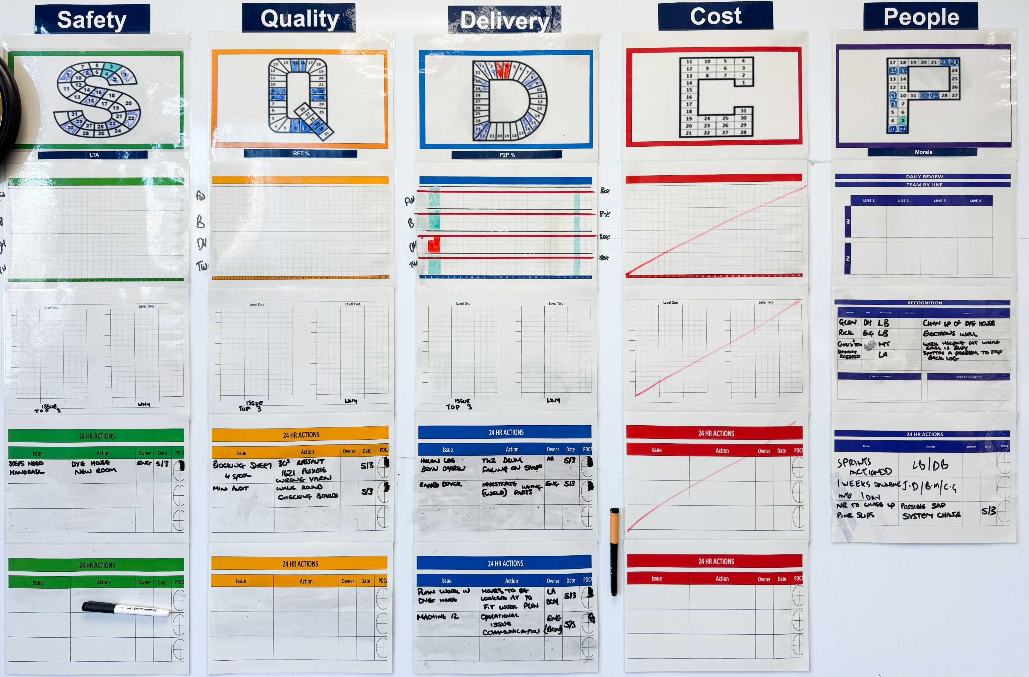
THE
SQDCP-
BOARD

Slide 12
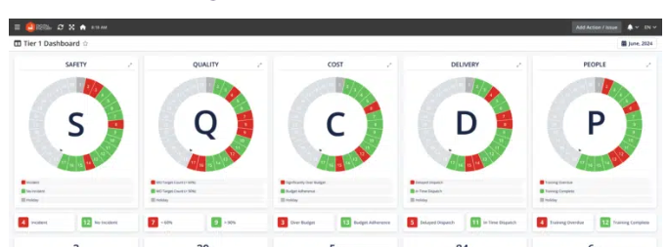
THE SQDCP-BOARD
The TIER meeting consistently follows a structured format based on the categories: Safety Quality Delivery Cost People

Slide 13
SQDCP-Board-Management
Who is Responsible for Filling Out the SQDCP Board in the AMANN Group
At the AMANN Group, the SQDCP board is filled out collaboratively by the team, with clearly assigned responsibilities to ensure consistency and accountability:
Team Leaders / Shift Leaders
Are primarily responsible for collecting and documenting daily data in all SQDCP areas. They ensure that the board reflects current performance and issues.
Operators / Team Members
Contribute relevant observations, incidents, or updates in their respective work areas, particularly in the categories of Safety, Quality, and People.
Supervisors / Department Heads
Review the board regularly, support escalations, and ensure follow-up on open actions. They also validate the accuracy and completeness of the entries.
TIER Meeting Facilitator (if assigned)
Supports the structured discussion during the meeting, ensures the board is updated in real time, and highlights deviations that require escalation.

Slide 14
SQDCP-Board-Management
How to Fill Out the SQDCP Board
The SQDCP Board is structured to reflect daily performance in five key areas:
S – Safety Record any safety incidents, near misses, or safety observations. Mark green if no issues occurred, yellow for minor observations, and red for incidents. Add short notes or actions if needed.
Q – Quality Document quality issues such as defects, rework, or complaints. Use color coding to indicate the status (green = OK, red = deviation). Briefly describe root causes or corrective actions when applicable.
D – Delivery Track delivery performance (e.g., on-time delivery, production output vs. plan). Green if targets are met, yellow if at risk, red if missed. Note any delays or bottlenecks with action points.
C – Cost Show deviations in scrap rate, resource usage, or cost overruns. Color code based on deviation level. Add causes and countermeasures where necessary.
P – People Reflect team-related topics like absenteeism, training, staffing, or motivation. Mark status and comment on any team-related challenges or improvements.

Slide 15
SQDCP
SAFETY Is at the heart of everything we do.
QUALITY the adherence to predefined specifications, standards, and best practices throughout the production process.
DELIVERY Meeting delivery timelines and accurately fulfilling orders is critical for customer satisfaction and maintaining business relationships.
COSTS The overall sum of money required to manufacture a product.
PEOPLE The heartbeat of the factory that drives the manufacturing process and adds value to raw materials. People are everything to the business, without people, There is no business.

Slide 16
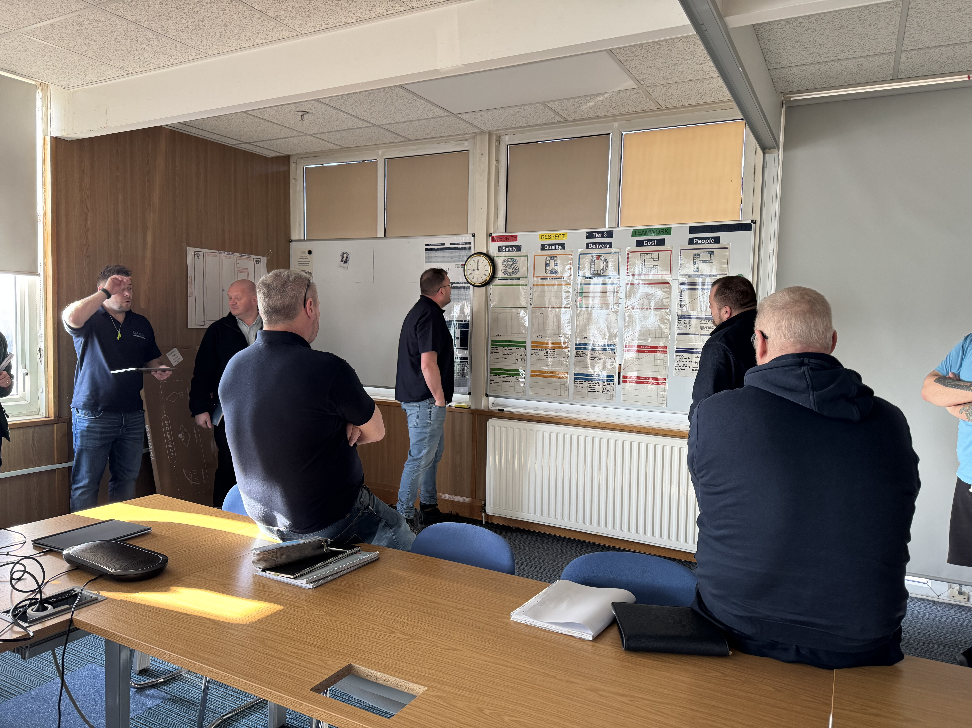
Benefits of the TIER Process for AMANN Group
For Employees:
Greater clarity and sense of ownership
Quick feedback and prompt action
Acknowledgement of raised concerns
For the Organization:
Accelerated problem-solving
Strengthened governance
Consistent and aligned communication strategy

Slide 17






Key benefits
Key benefits for AMANN Group with TIER COMMUNICATION and SQDCP-BOARD MANAGEMENT
Improved communication
By involving various levels of employees in regular meetings, information is shared more readily, breaking down silos and aligning teams across the production process.
Faster problem-solving
Issues are identified and addressed quickly at the lowest possible level, with escalation to higher tiers only when necessary.
Enhanced accountability
Each level is responsible for addressing their own issues and reporting progress, promoting ownership and proactive problem-solving.

Slide 18
6 Key Takeaways from TIER Meetings
Clear Structure and Focus
  Discussions follow a standardized agenda (S-Q-D-C-P), ensuring relevance and efficiency.
Faster Issue Resolution
  Problems are identified and escalated quickly, allowing for timely solutions.
Improved Team Communication
  Promotes open, transparent dialogue across all levels of the organization.
Data-Driven Decisions
  Visual tools and trackers support fact-based discussions and action planning.
Employee Involvement and Ownership
  Team members are empowered to raise issues and contribute to continuous improvement.
Alignment with Company Goals
  Ensures daily activities and decisions are in sync with AMANN Group’s strategic objectives.

Slide 19
Reflection: How can you apply TIER in your role?
Which issues should be escalated to the next tier to avoid delays or cost impacts?
  Think about which topics exceed your responsibility or require broader decision-making.
What types of problems can and should be solved directly at your level?
  Consider how you can take ownership to reduce inefficiencies and save time.
How do you currently ensure that follow-up actions are tracked and completed?
  Reflect on your habits and tools to keep tasks visible and closed effectively.
How can applying the SQDCP structure help reduce waste or prevent errors in your daily work?
  Identify concrete ways to increase productivity through better structure.
In what ways does TIER support faster decision-making and better use of resources in your area?
  Think about how clear communication and visibility improve results.
What can you personally do to make your team’s TIER meetings more impactful and result-oriented?
  Focus on actions that bring clarity, save time, and improve outcomes.

Slide 20
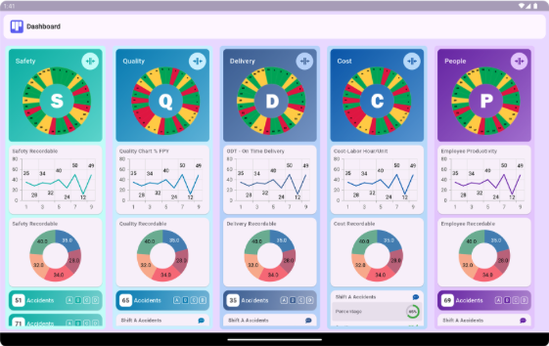
The AMANN-SQDCP-TIER-Board
soon …

Slide 21
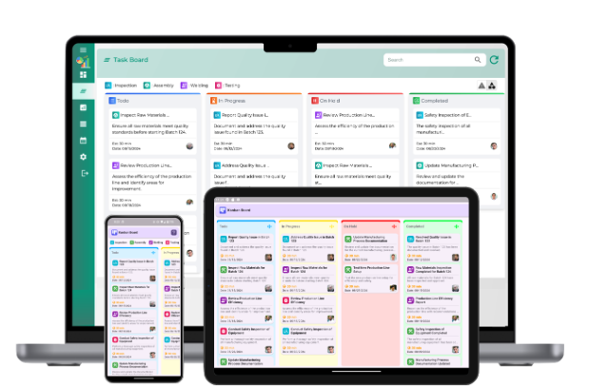
Future of AMANN-TIER-Board-Communication

